Slide 1
Paraffin bATH
BY: Justin Putman
Moore Traditional School

Slide 2
Paraffin bath
A Paraffin bath is heating treatment used for medical reasons. Paraffin baths alleviate pain from any joint condition, or injury.
Consists of a mixture of seven parts of wax
Must be maintained at a temperature of 118 to 227 degrees F
The Paraffin remains on the skin, retaining the heat and allowing it to a reach deep-tissue level.
The paraffin bath can be used for injuries such as inflammation of the skin, arthritis, and bursitis.
Parts of the body : Hands, wrists, elbows, ankles, and feet
It can also be used for sprains and strains.
Plastic bags, paper towels, and cloth are needed along side paraffin bath
Cleanse and dry the affected extremity before immersing it in the paraffin bath
When the dipping is complete, cover the dipped body part with a plastic bag and wrap it a towel.
The paraffin treatment is left on 15 to 20 minutes until heat has stopped generating.
Make sure to peel of the wax with an tongue depressor

Slide 3
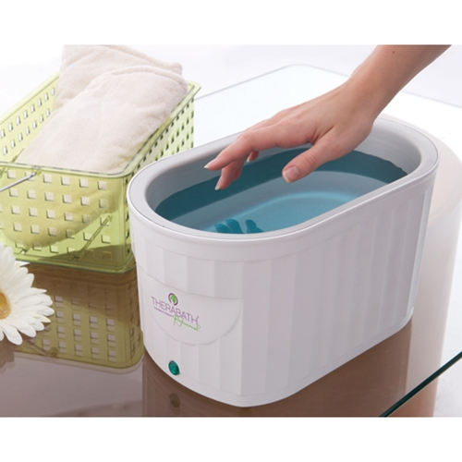

Slide 4
https://www.youtube.com/watch?feature=player_detailpage&v=wnkqiMrR4fk

