Slide 1
PHYSICAL Therapist
By Justin Putman

Slide 2
Physical Therapist
A physical therapist is a healthcare professional who works with patients who have physical impairments or limitations.

Slide 3
Employment opportunities and expected salary
General medical and hospitals.
Outpatient clinics
Rehabilitation Hospitals
Home health care services
Nursing care facilities,
Private practice
Corporations
Armed services
Sports teams
School teams

Slide 5
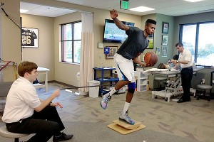

Slide 6
Works cited page (Justin Putman)
http://www.ehow.com/facts_5020229_definition-physical-therapist.html
http://www.angelo.edu/dept/physicalhttp:/
/espn.go.com/nba/draft2013/story/_/id/9300302/prospective-no1-pick-nerlens-noel-eyes-lottery-fate_therapy/careers.php
http://jeanpaoloalminar.wordpress.com/2010/05/09/physical-therapy-ano-ba-ito/

