Slide 1
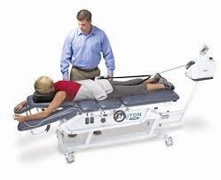
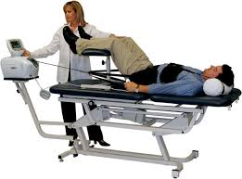
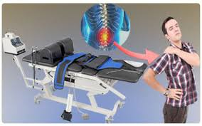
Therapeutic Traction
Ian C
Moore Traditional School
2/27/15

Slide 2
Spinal Traction
Spinal traction is a form of decompression therapy that relieves pressure on the spine. It can be performed manually or mechanically.
Patients with spinal conditions benefit from this therapy because the traction reverses the force of gravity. It is most commonly used to treat slipped discs, bone spurs, degenerative disc disease, herniated discs, facet disease, sciatica, foramina stenosis, and pinched nerves.

Slide 3
Exercises for Spinal Traction
lying on the floor with your feet supported by a chair or sofa. Your knees and hips should be at 90 degrees. Gently push against your thighs with your hands; you should feel light separation in your lumbar spine. Hoffman recommends holding this traction for two minutes, then rest and repeat up to five times so 10-20 mins

Slide 4
https://www.youtube.com/watch?v=siSuXrzZEn4
www.healthline.com/health/spinal-traction#Overview1

