Slide 1
Transcutaneous electrical nerve stimulation (Tens)
By: Mary (:
3rd period
Moore Traditional School

Slide 2
TENS
It Transmits low-level electrical charges into area where pain is
Many says the tens machine is best used after surgery's and for sprains and fractures
TENS may also be helpful for some chronic pain conditions

Slide 3
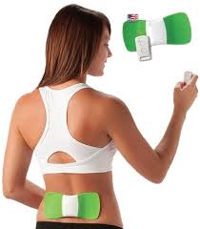
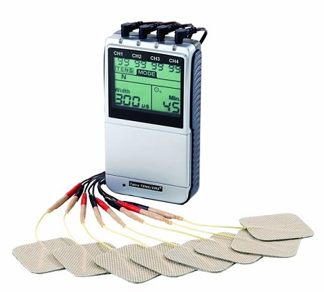
WHY YOU WOULD USE TENS
Lower back pain
Neck pain
Labor pain
Long lasting (chronic) pain , cancer pain

Slide 4
RESOURCES
http://www.tensunits.com/
http://www.patient.co.uk/health/tens-machines

